Slide 1
Winfred Gatua
14/06/2023
P3_Away_Day

Slide 2
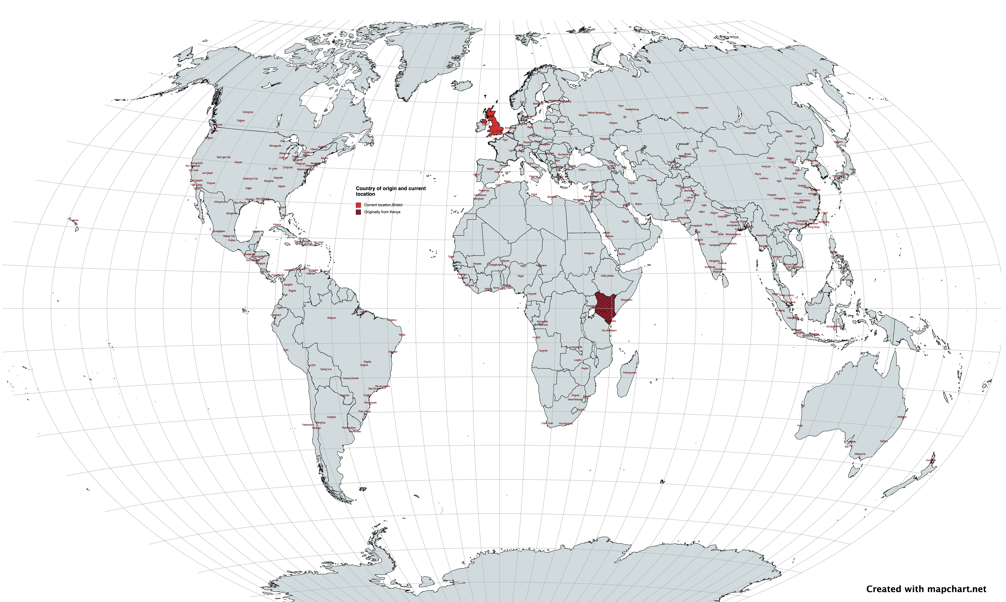
PhD Student
(MGLE, University of Bristol)
2021 - 2025

Slide 3
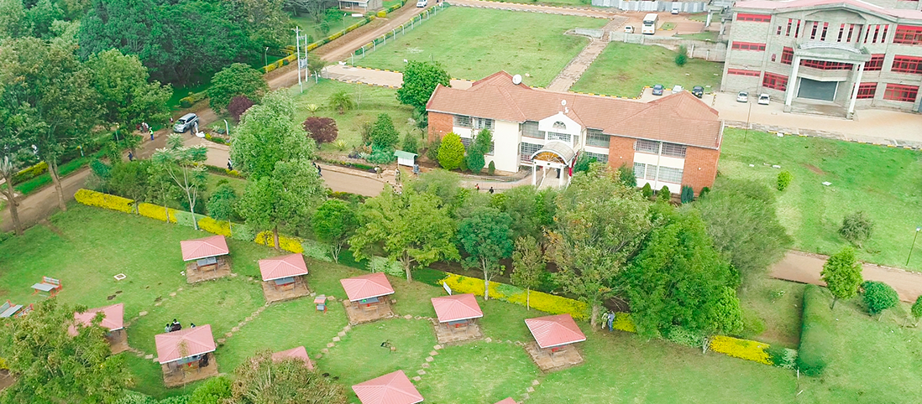
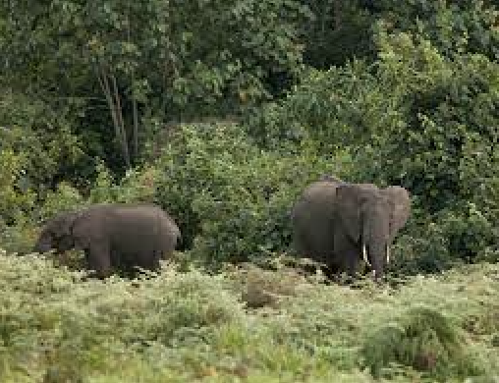







BSc Biomedical Science and Technology (Laikipia University, Kenya)
2013 - 2017
PGD Health
Graduate Intern
Research Methods (Pwani University & KWTRP , Kenya)
(Institute of Primate Research, Kenya)
2016 - 2018
2018 - 2019
MSc Bioinformatics (Pwani University &
ICIPE , Kenya)
2019 - 2021

Slide 4




Research motivation
Genomics and genetics of human complex diseases

Slide 5

Grand Challenge

Slide 6
Summary
Mendelian whispers
Guiding trials with precision
Truth from genes revealed.

